Slide 1
Sunnyvale Football
By Sam Knight

Slide 2
Goals
Find most impactful players
Find best performing seasons
Find correlation between players and season outcome
Notes:
Project done for Don Griffing at ___ who does radio broadcasts for the Sunnyvale Varsity football games. I was asked to gather the data to make it more convenient to pull the stats in the future. I also analyzed the data to look for memorable trends and patterns in past seasons. I did this by focusing on three different aspects of Sunnyvale football. First, I looked at players statistics( mainly passing, rushing, receiving, and kicking) to look at who were the top performers at various aspect of their positions. Second, I looked at season performances. This involved looking at the outcome of each seasons (win %, post season record, scoring margins, etc.) and by analyzing season statistics ( yards, TDs, etc.).
Finally, and most importantly, I wanted to look at the data for both players and seasons to see how they relate. I wanted to see to what extent did a player's performance altered a teams outcome. Was it a strictly linear relationship (the better a player did, the better the team did) or was there a diminishing impact? It was my goal to make these discoveries.

Slide 3
Intro and Disclaimers
Data was found using MaxPreps and Hudl
Data is from the years of 2011-2023
Defensive stats were not included due to lack of data
Used Excel to organize and analyze data
Used PowerBI for visualizations
Notes:
Data was found using MaxPreps and Hudl. This data relied on the coaches to manually input it on the websites after each game. This sometimes led to conflicting data or just outright missing information. This is the primary reason why this analysis will be lacking defensive statistics. I found very little consistent data on the Sunnyvale defense. Therefore, I would classify this data and analysis to primarily focused on offense. The data begins in 2011 because that is when the Sunnyvale varsity football team was formed.
I put all the data in various excel sheets where I organized and analyzed them using various tools available to the program such as pivot tables

Slide 4
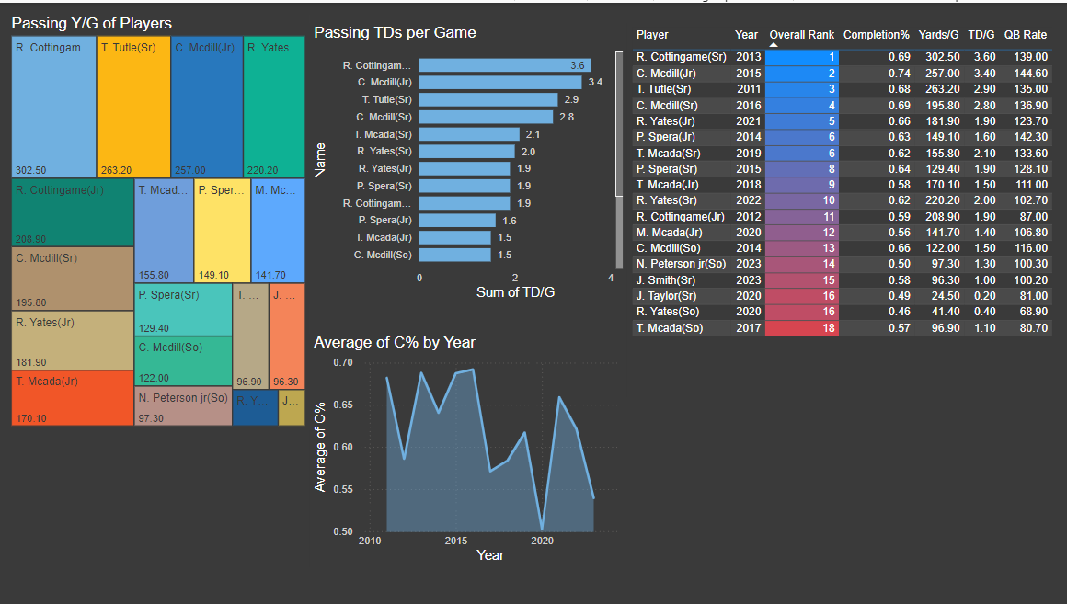
Player Passing
Notes:
The top performers in most categories was Ryan Cottingame(2013), Caleb Mcdill(2015 and 2016) and Tanner Tuttle(2011). Most statistics were highest from 2011-2016. You can observe the decline with the completion percentage that started to dip in 2017.

Slide 5
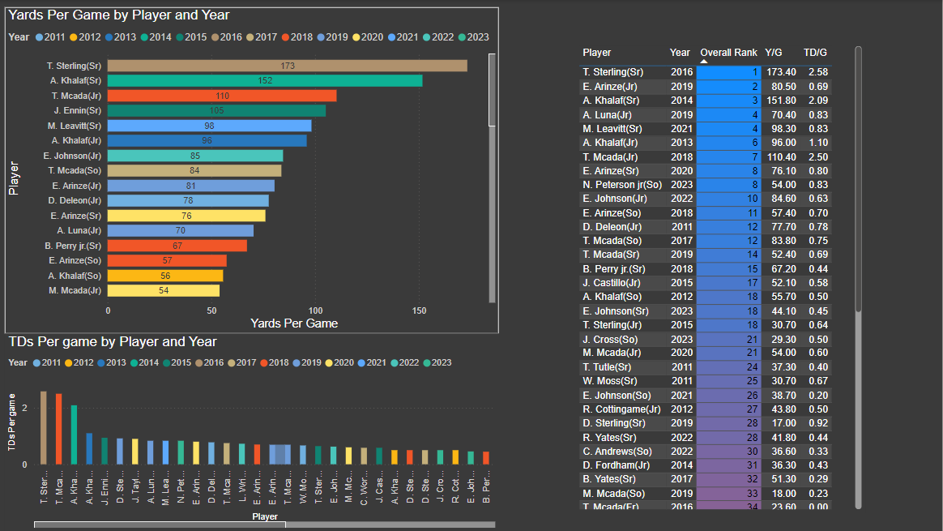
Player Rushing
Notes:
Tre Sterling was by far the highest performing running back in school history. Arinze and Khalaf also had great performances. It’s also important to note that quarterback Tripp Mcada(2017-19) had very strong rushing numbers as well(ranked 7th). 2019 was a strong year for rushing as he, Luna, and Arinze ranked among the best all time.

Slide 6
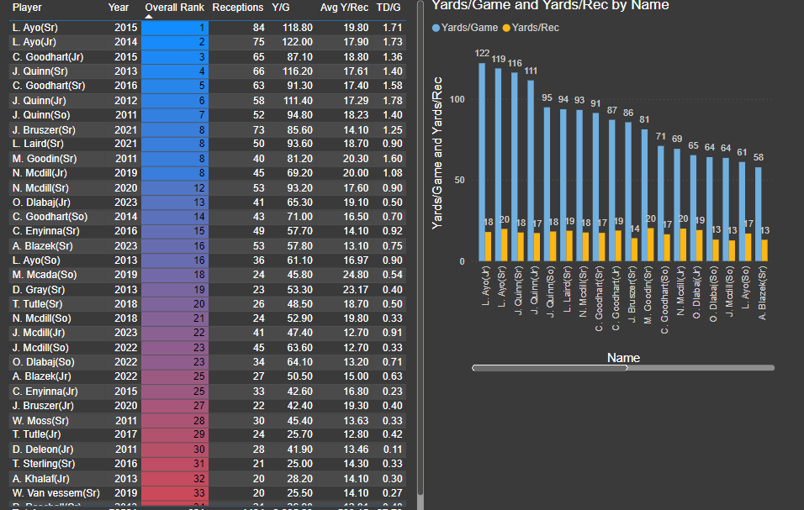
Player Receiving
Notes:
Lawson Ayo(2014 and 2015) and Cash Goodhart (2015 and 2016) were the top performers as they had 4 seasons ranked in the top 5 for receiving. This makes sense considering 2015 was one of the best passing years. Considering our findings that the first half dozen years were the strongest passing years for Sunnyvale, it only makes sense that receiving reflected that as well.

Slide 7
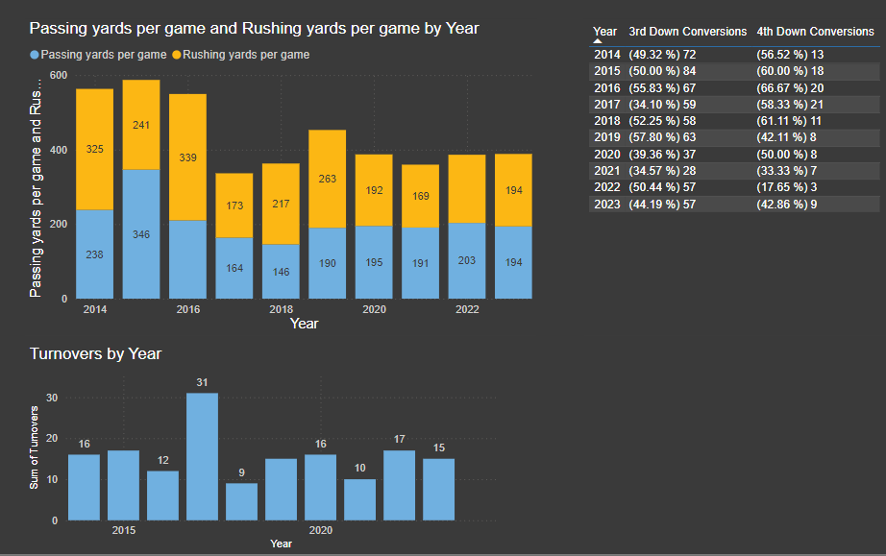
Season Statistics

Slide 8
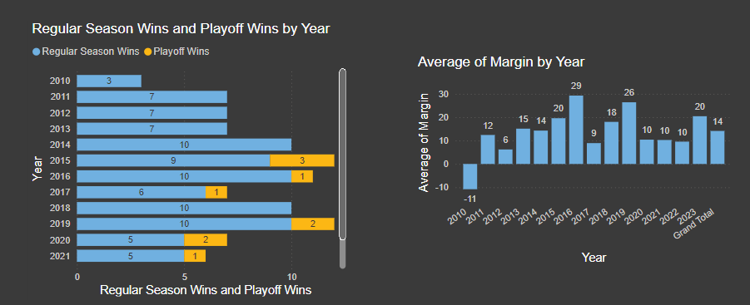
Season Performance

Slide 9
Conclusions
Stats and results reflect move to stronger classification
2015 and 2016 resulted in the strongest individual performances
Sunnyvale was competitive and relatively successful most years
Notes:
Stats and results reflect move to stronger district. After 2016, it can be seen that the performances have for the most part come short of the earlier years. 2015 and 2016 featured the strongest individual performances with Caleb Mcdill, Tre Sterling, Lawson Ayo, and Cash Goodhart leading their respective positions. Despite a lack of deep playoff runs, Sunnyvale’s stats were far better than the average high school team and the team found success while making it to the playoffs most years.

